Slide 1
Estimation of Medical Diagnostic Likelihood Ratios Using Artificial Intelligence
M2int lab meeting
Sept 22, 2025
Authors: Paul Chong, MD; Shuhan He, MD; Kian Samadian, MD; Cory Rohlfsen, MD; Brian W. Locke, MD MSCI
Presented by: Brian Locke MD MSCI

Slide 2
Summary: LLMs to Estimate Diagnostic LRs
Problem: Bayesian reasoning requires likelihood ratios (LRs).
Approach: Ask LLMs to estimate LRs for findings.
Claim: Modern large language models (LLMs) approximate diagnostic LRs with negligible bias and bounded dispersion.
Payoff: Usable evidence weights when data are thin.

Slide 3
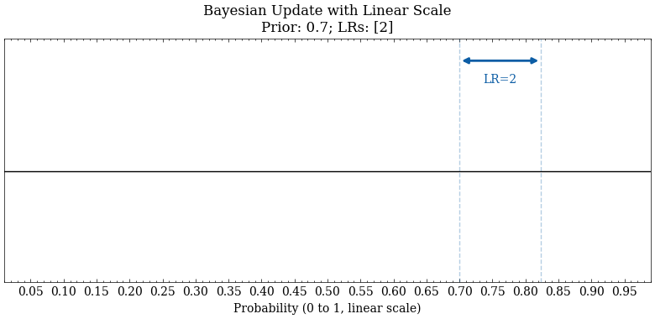
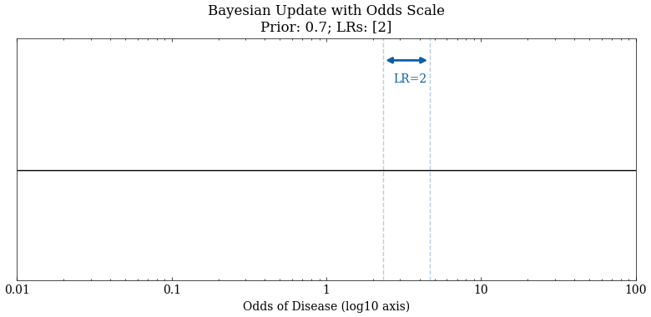
Bayesian Reasoning
Pretest odds × LR = Posterior odds
Why LRs? portable across pretest; multiplicative; chain rule
Limitations: assumed LR independence, LR spectrum
Example:
Pre-test Probability = 0.7; LR = 2
Pre-test Odds = 0.7/0.3 = 2.33
Post-test Odds = 2.33 * 2 = 4.66
Post-test Probability = .833

Slide 4
Bayes needs explicit evidence weights
Clinicians default to gestalt.
Empiric LRs are scarce, context‑dependent, and slow to produce.
Diagnostic Test Accuracy Studies
Goal: Test whether LLMs can supply valid, auditable LR estimates at scale.

Slide 5
LR scarcity vs LR necessity
Condition–finding–context space is combinatorially large; exhaustive LR measurement is infeasible.
Diagnostic accuracy studies are costly, slow, and often non‑transportable.
Therefore: inferred LRs are not a convenience but a requirement for scalable Bayesian care.
Hypothesis: LLMs can produce valid, auditable LR estimates to fill the gap.

Slide 6
Why LRs Are Scarce
Condition–finding–context space is huge.
Accuracy studies are costly and slow.
LRs drift with spectrum and setting.
Bottom line: we need credible estimates.

Slide 7

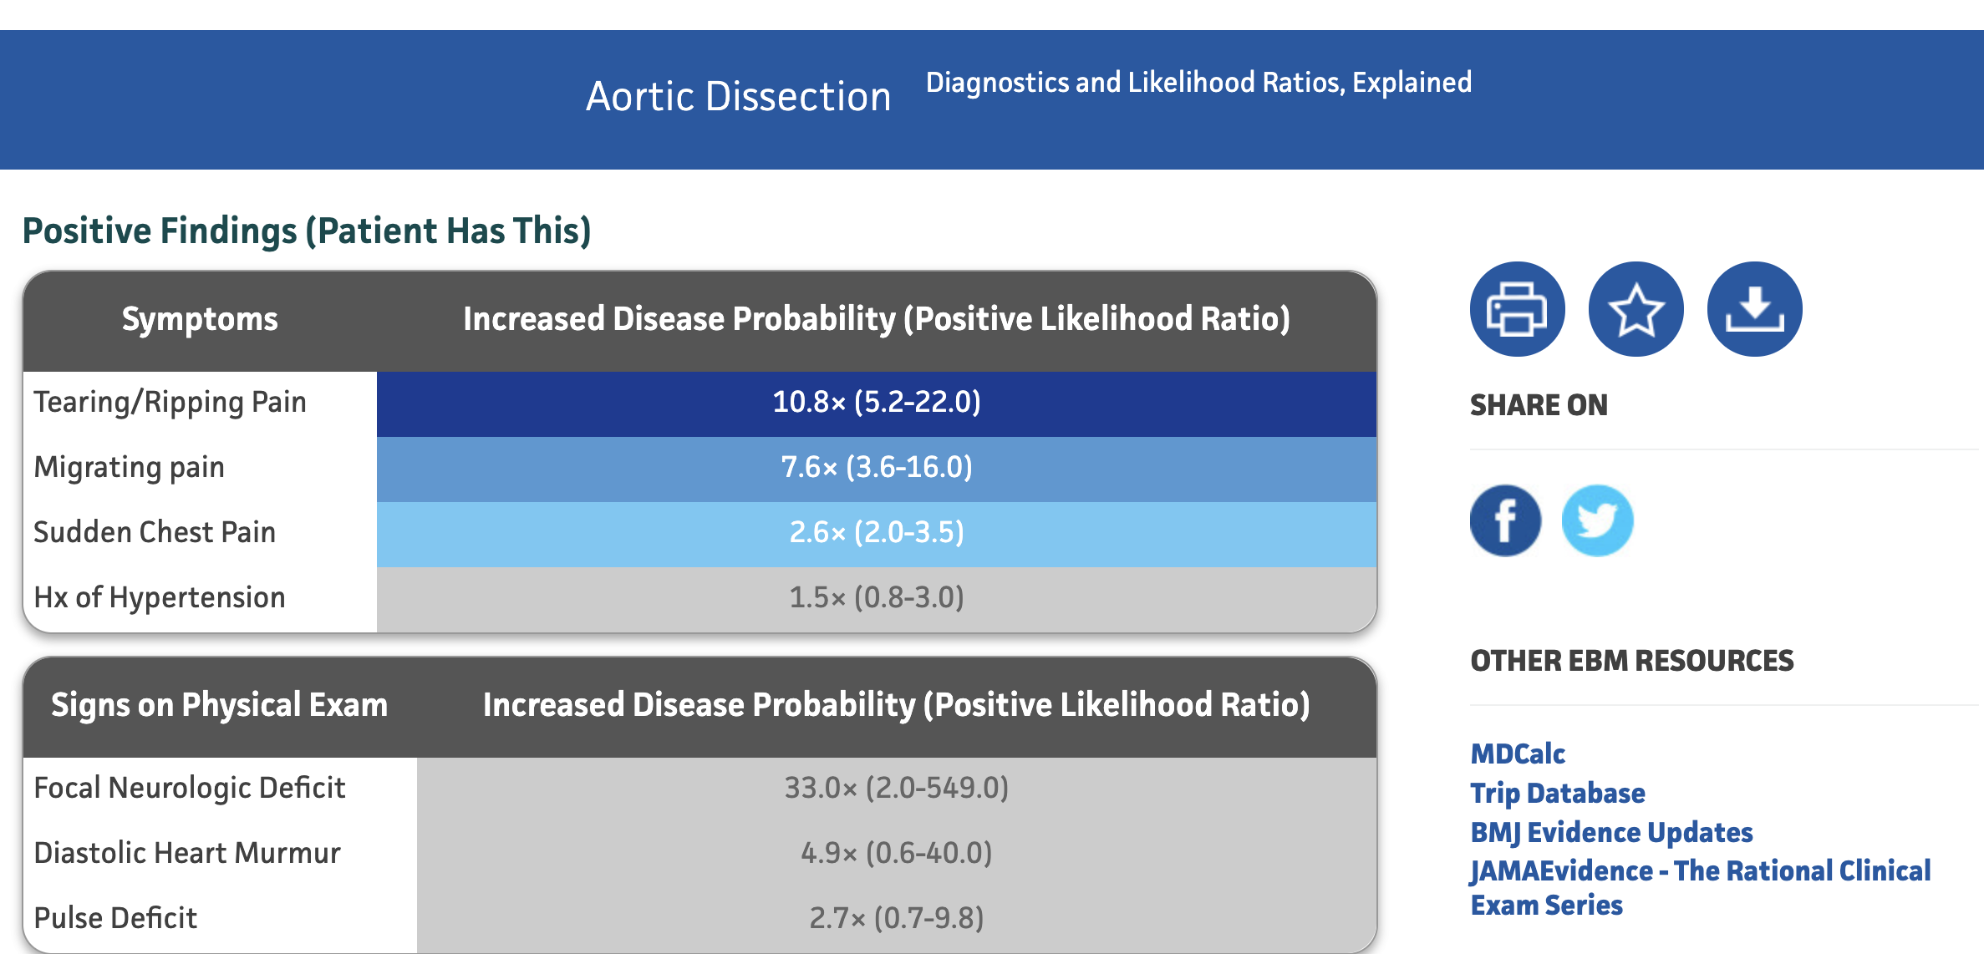
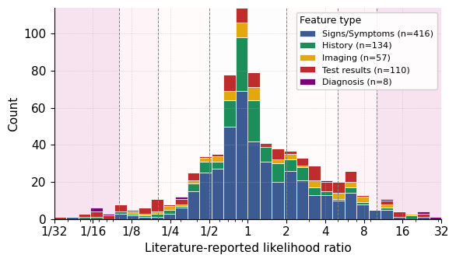
Statistic | Overall | Test results | Imaging | History | Signs Symptoms | Diagnosis
Count | 700 | 110 | 57 | 134 | 416 | 8
Geometric mean | 1.206 | 1.071 | 1.322 | 1.065 | 1.267 | 1.164
5th percentile | 0.190 | 0.060 | 0.200 | 0.226 | 0.360 | 0.064
25th percentile | 0.700 | 0.312 | 0.680 | 0.755 | 0.700 | 0.077
50th percentile | 1.000 | 1.000 | 1.000 | 0.995 | 1.000 | 2.057
75th percentile | 2.200 | 3.675 | 3.300 | 1.675 | 2.100 | 16.300
95th percentile | 7.905 | 15.550 | 12.000 | 5.085 | 7.225 | 26.300
Min | 0.010 | 0.010 | 0.010 | 0.050 | 0.040 | 0.060
Max | 145.894 | 145.894 | 34.400 | 18.500 | 57.000 | 27.000
Notes:
6) TheNNT as a clinical resource
• What it is: Curated diagnostic LRs from the literature for bedside use.
• Why it matters: Clinician‑facing, transparent, broad coverage across common conditions.
• Caveats: Heterogeneous contexts; variable study quality; spectrum/transport issues.
\
Reference set we used (from TheNNT)
700 literature‑reported LRs across 30 conditions; compiled April 1, 2025.
Types represented (not mutually exclusive): signs/symptoms 59% (416), history 19% (134), tests 16% (110).
Distribution: geometric mean 1.21; IQR 0.7–2.2; most LRs cluster near 1 (negligible/weak evidence).

Slide 8
Study design & models
Task: Compare LLM‑estimated LRs to TheNNT values for each finding–condition pair.
Models: GPT‑4o, o3, GPT‑5 (increasing recency/ability).
Date of LLM queries: Aug 25, 2025.
No web access; no fine‑tuning; few‑shot only.
Agreement assessed with Bland–Altman on log‑LR (ratio limits reported)

Slide 9
Prompt Strategy:
System role: “Bayesian diagnostic assistant”; return only JSON {"value": float>0}.
Definition shown: LR = P(finding | diagnosis) / P(finding | not‑diagnosis).
Few‑shot: 8 examples for non‑reasoning model; 2 for reasoning models; examples are clinician‑estimated, not scraped.
Inference:
GPT‑4o temperature 0.2;
o3/GPT‑5 reasoning effort “medium”;
verbosity minimized;
structured outputs enforced with schema.

Slide 10
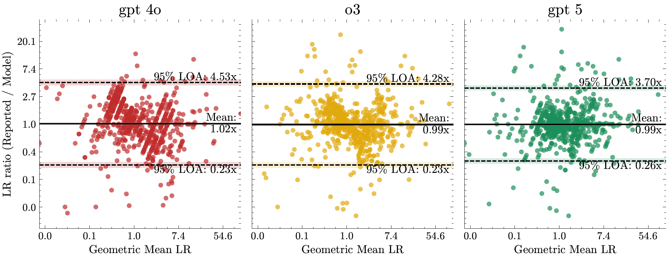
Results
Coverage | Lower edge (95% CI) | Upper edge (95% CI)
50% | 0.63x (0.59x - 0.66x) | 1.56 (1.47x - 1.65x)
75% | 0.46x (0.43x - 0.49x) | 2.15 (2.01x - 2.29x)
90% | 0.33x (0.30x - 0.35x) | 2.99 (2.77x - 3.23x)
95% | 0.26x (0.24x - 0.29x) | 3.70 (3.40x - 4.03x)
99% | 0.17x (0.16x - 0.19x) | 5.61 (5.05x - 6.22x)

Slide 11
Qualitative Agreement
LR evidence bands (reference):
>10 strong for;
5-10 moderate for;
2–5 weak for;
0.5–2 negligible;
0.2-0.5 weak against;
0.1-0.2 moderate against;
≤0.1 strong against
Notes:
Newer model tighter dispersion; qualitative category agreement substantial (GPT‑5 κ≈0.78).

Slide 12
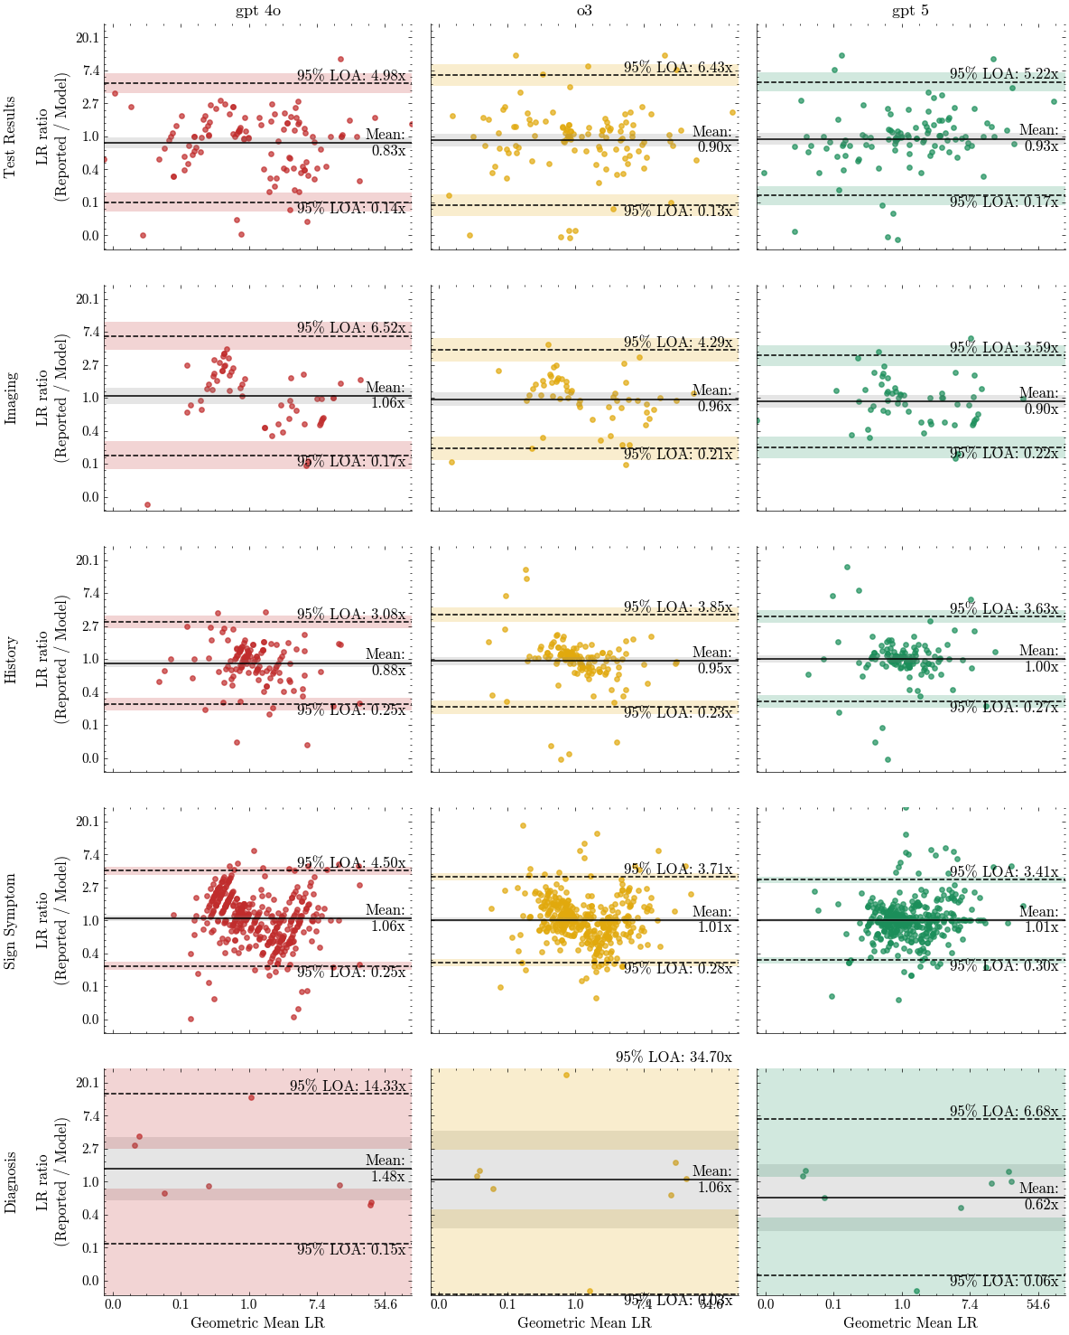
Results

Slide 13
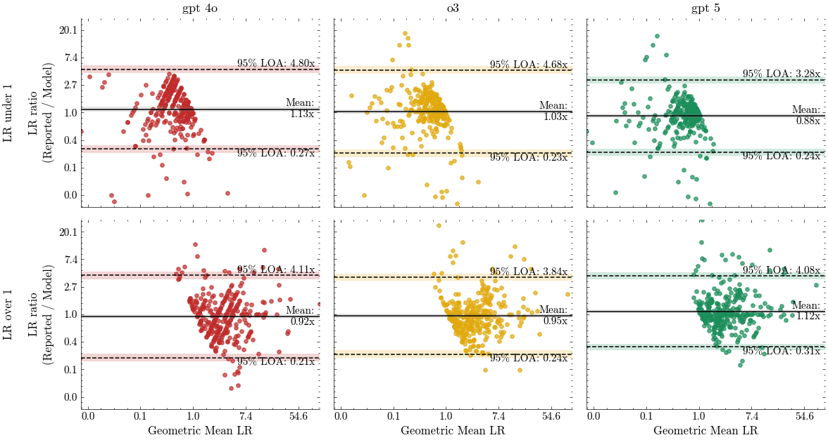
Results

Slide 14
Results

Slide 15
Conclusion
“We found that LLMs estimated diagnostic LRs with negligible mean bias and bounded dispersion, with the newest model, GPT-5, showing the closest agreement with literature-reported values (95% limits of agreement of 0.26×–3.70×).
Agreement varied by finding type, with laboratory test results showing looser agreement than history, signs/symptoms, or imaging results.
Qualitative category agreement was substantial (κ = 0.78 for GPT-5).
Together, these results suggest LLM-estimated LRs can support Bayesian reasoning when empirical LRs are absent, inapplicable, or uncertain.”

Slide 16
Limitations
Contamination: TheNNT LRs likely present in pretraining; some agreement may reflect prior exposure.
Minimal Regurgitation
Influence on weights in the training data?

Slide 17
Implications
Clinical takeaway: LLM‑estimated LRs can act as auditable evidence weights for Bayesian updating; use serially, not as single decisive tests; integrate with teaching and decision support now, validate prospectively for discovery later.
Likely less useful for estimating a single key finding then multiple findings that are then chained together.
”Naïve Bayes Miracle”

